Slide 1
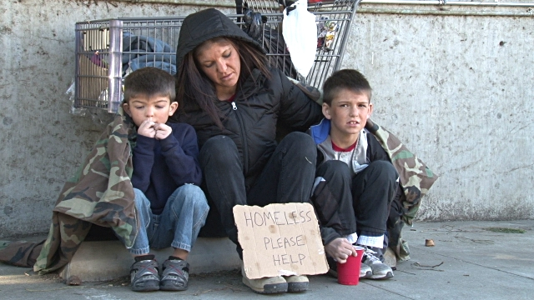
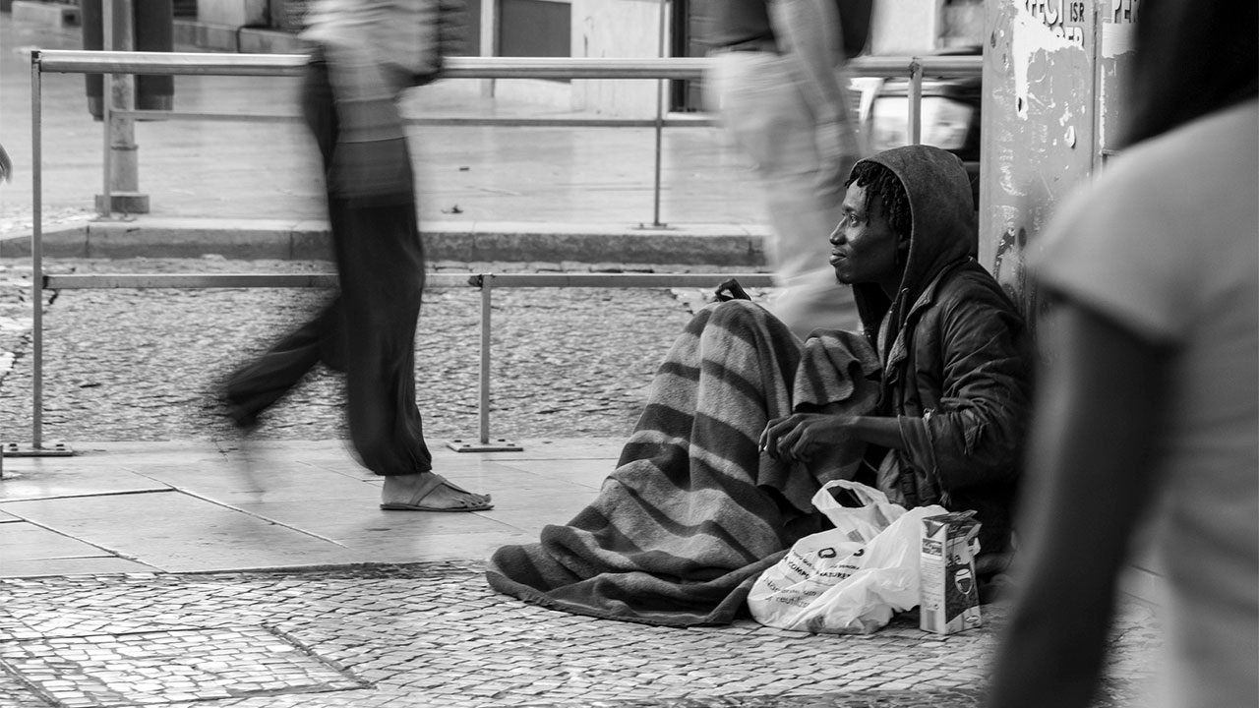
Investigating Homelessness in the U.S.
Chidima Okorie, Ugonma Ibeabuchi & Julia Gajda
Notes:
CHIDIMA

Slide 2

Our Hypothesis
What is the relationship of homeless rates with the US population size and the funding allocated in various US states for Beds (for individuals who are homeless)?
The greater the general U.S. population size, the greater the rate of homelessness and vice versa.
Notes:
CHIDIMA

Slide 3


Datasets Sources:
Department of Housing and Urban Development (HUD) data
Homeless Population, estimated Point In Time count for 2018.
Housing Inventory Count, 2018
https://www.hudexchange.info/resource/3031/pit-and-hic-data-since-2007/
United States Census Bureau data
Estimated U.S. Census data for 2018
https://www.census.gov/data/datasets/time-series/demo/popest/2010s-national-total.html
Notes:
JULIA

Slide 4
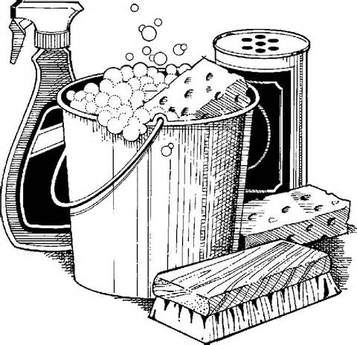
Data Exploration
What we found:
Our datasets had too many variables and not enough variable
Missing values wasn’t an issue with our datasets
Relationship between our variables wasn’t quite clear when we looked at the data manually, however, once we began to build charts to visualize it, it became clear.
Rate of homelessness in a state was significantly lower than the general population size.
Most states seem to have # of beds available that are relative to the rate of homelessness
Double checked/calculated our data through data aggregation
- Now, we know how to properly visualize our data in a meaningful way.
Data Cleaning
For our individual data sources, we had to:
Remove the additional rows above the title row
Convert each file from excel to csv
Dropped redundant and
Once data was aggregated, we had to:
Dropped rows with US territories
Dropped regional data
Notes:
UGONMA

Slide 5
Do State Population Size Affect Homeless Rate?
Notes:
CHIDIMA
Talk about our assumption of the greater the state size the greater the homeless rate and vice versa.

Slide 6
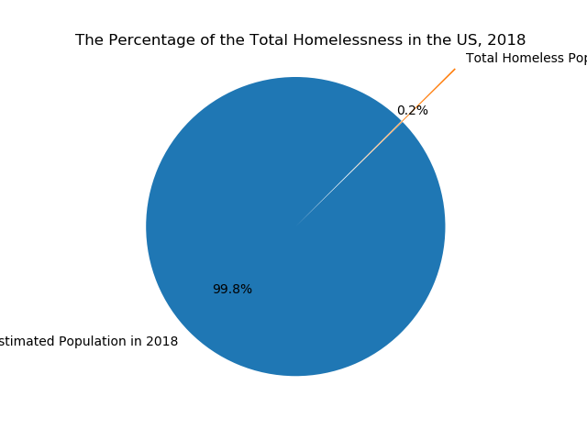
Notes:
We found that .2% of the US population experienced homelessness in 2018

Slide 7
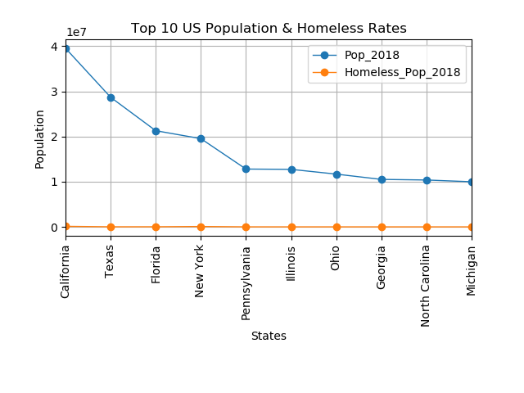
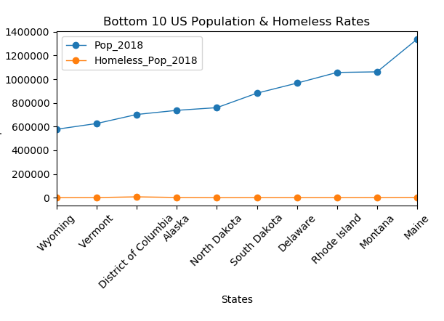
Notes:
CHIDIMA & JULIA

Slide 8
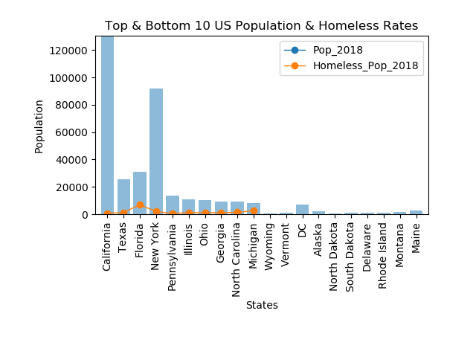
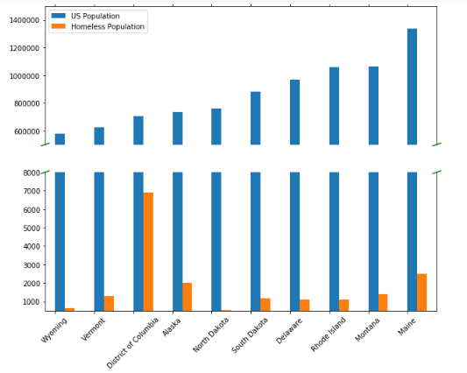
Notes:
CHIDIMA & JULIA
We found there was no correlation between homeless rate and gen. population

Slide 9
Is There A Type Of Homelessness That Is Prevalent In The US?
Notes:
JULIA

Slide 10
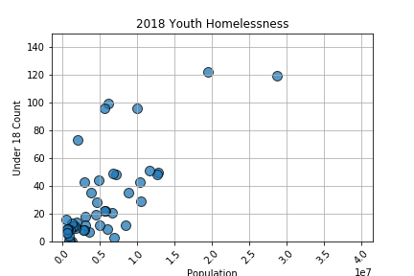
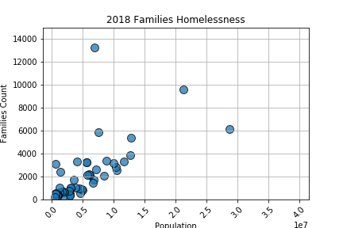
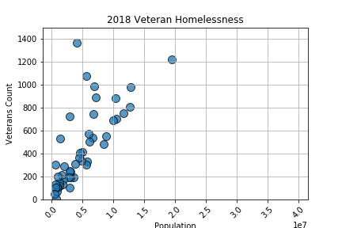
Notes:
JULIA

Slide 11
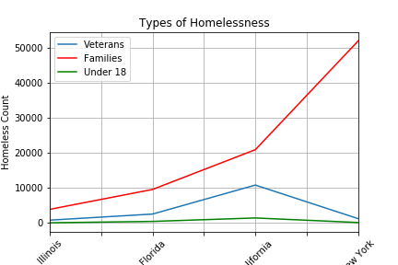
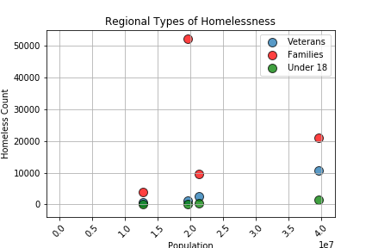
Notes:
JULIA

Slide 12
Do States Provide Beds Based On Number Of Homeless Individuals?
Notes:
UGONMA

Slide 13
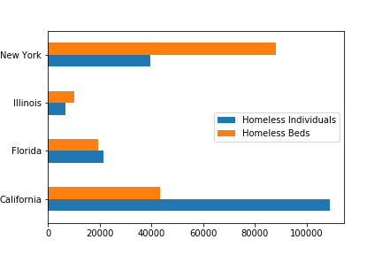
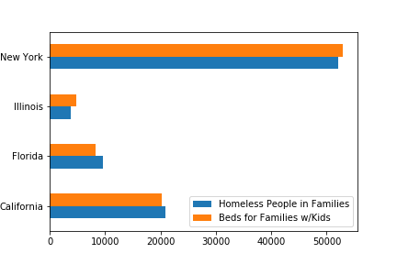
Are there enough beds to accommodate the # of estimated homeless individuals four of US’ largest states?
According to our analysis:
New York = 👍
Illinois = 👍
Florida = 👎
California = 👎
Limitations to the data.
Are there enough beds to accommodate the # of estimated homeless people in families in four of US’ largest states?
According to our analysis:
New York = 👍
Illinois = 👍
Florida = 👎
California = 👎
Limitations to the data.
Notes:
UGONMA

Slide 14
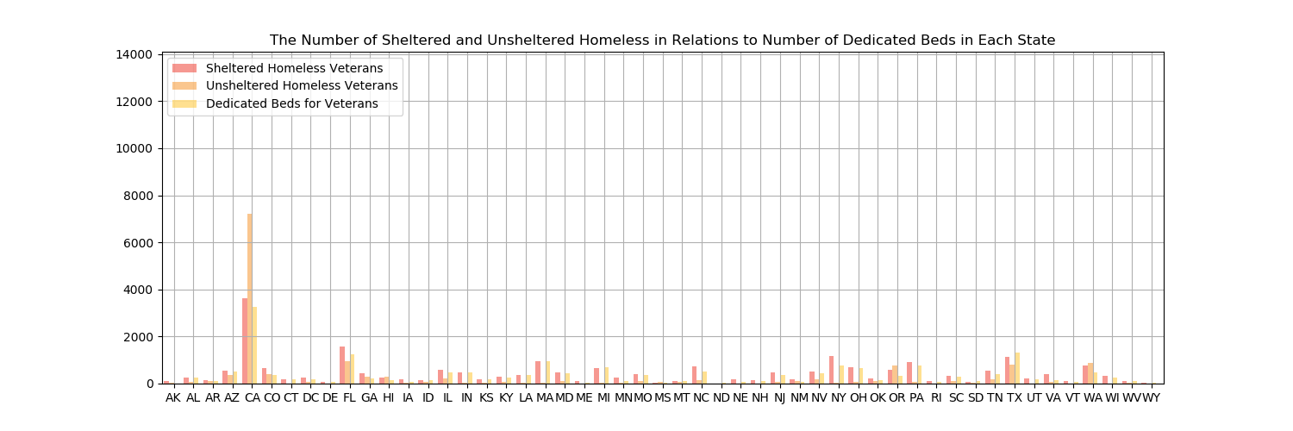
Notes:
UGONM
A

Slide 15
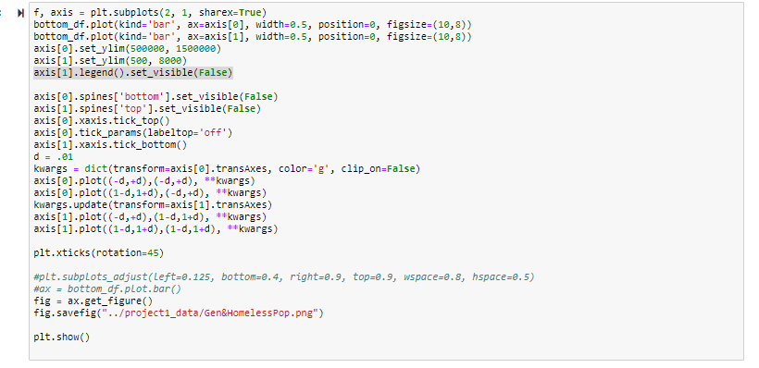
BREAKING THE BAR!
Notes:
Chidima
Why I needed this:
- Charting US state population (millions) and Homeless rates (thousands) on one chart.
I needed to assign 2 y-axes, with that I was able to:

Slide 16
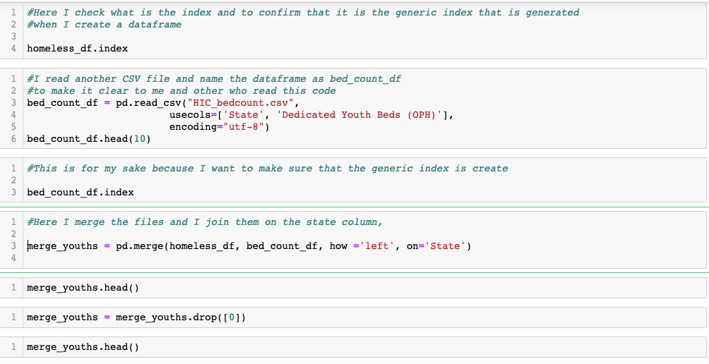
ASSIGNING INDEX
Notes:
Ugonma - This is the code where I can to force to assign the index because at some point, notebook doesn’t see the index of the files.

Slide 17
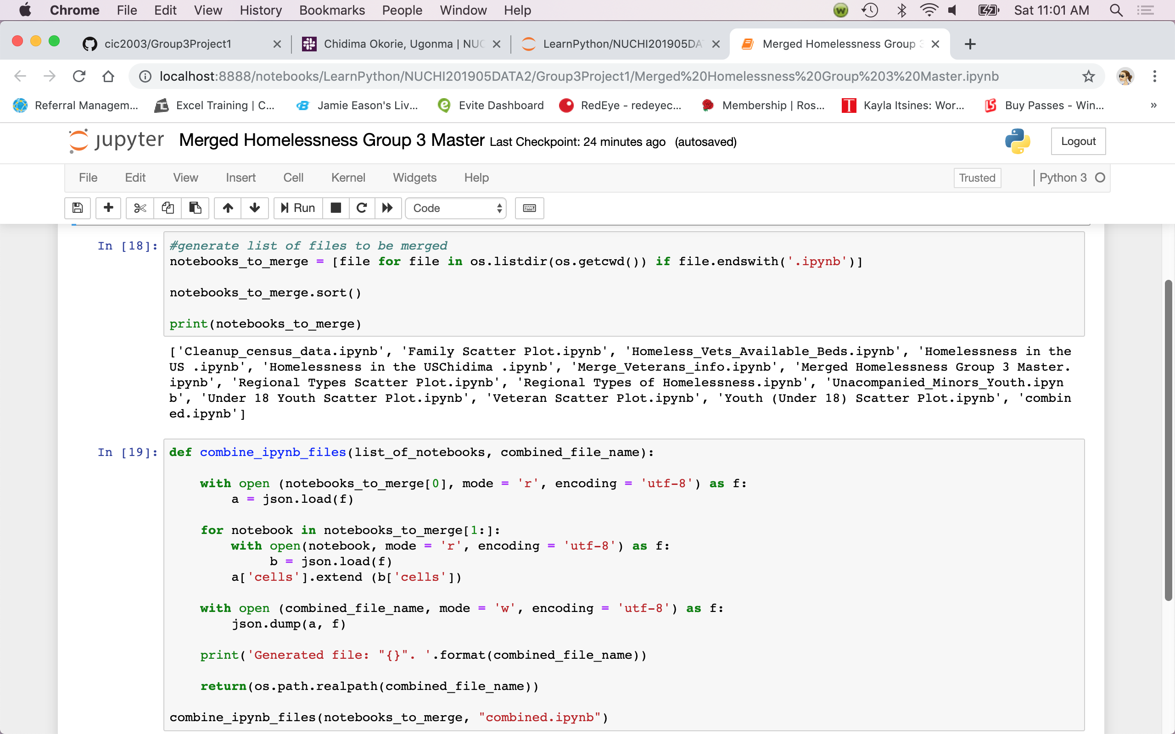
MERGING 12 Notebooks into ONE
Notes:
JULIA - used json to merge total of 12 notebooks into 1 code

Slide 18

WHAT WE FOUND:
Homeless individuals make up less than 1% of the U.S. population.
Majority are homeless adults, then homeless families.
There aren’t enough beds available for homeless individuals across the country
Notes:
UGONMA

Slide 19

IF ONLY WE HAD …..
MORE TIME/PATIENCE
API
STATISTICAL ANALYSIS
INTEGRATING OTHER DATASETS
ACCESS TO MORE DATASETS
FUNDING DATA
LENGTH OF HOMELESSNESS
ACTUAL # INSTEAD OF ESTIMATES
Notes:
ALL THREE OF US (CHIDIMA WILL START)

Slide 20
Thank you!
Any Questions?

